Slide 1
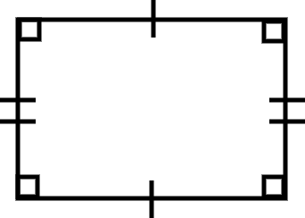
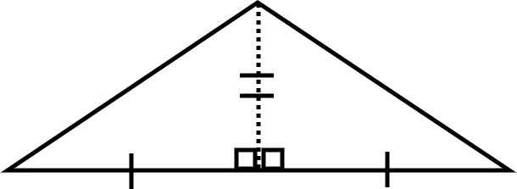
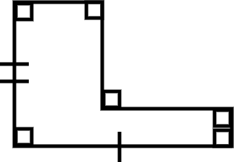
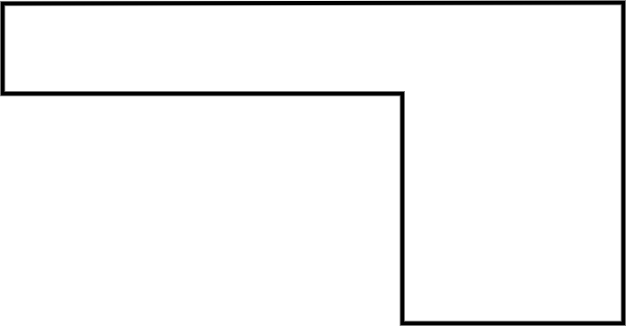
Area of composite rectilinear shapes
Task A: Comparing areas
1) Order the shapes from smallest to the largest area.
a) b) c)
Task B: Three methods to find the area
1) Calculate the area of this composite rectilinear shape using each of the three methods.
Which is most efficient?
Justify your choice.
14 units
9 units
7 units
2 units
9 units
5 units

Slide 2
Area of composite rectilinear shapes
Task C: Evaluating the methods
1) Draw your own composite rectilinear shape and try to find the area using the three methods.
Can you draw a shape where one (or more) of these methods would not be helpful?
Mathematics in Education and Industry.

